Slide 1


SQL Server Best Practices
Prima Management Services Pvt Ltd

Slide 2
Introduction
This presentation focuses on the standardized approach to SQL Server development within Prima Management Services. By implementing naming conventions, ensuring consistency, optimizing performance, and strengthening security, PMS aims to promote a structured software development methodology.
1
Standardization
2
Focus Areas
3
PMS Methodology
SQL Server development to enhance maintainability and clarity.
Naming conventions, consistency, performance, and security.
Based on PMS's structured software development approach.

Slide 3
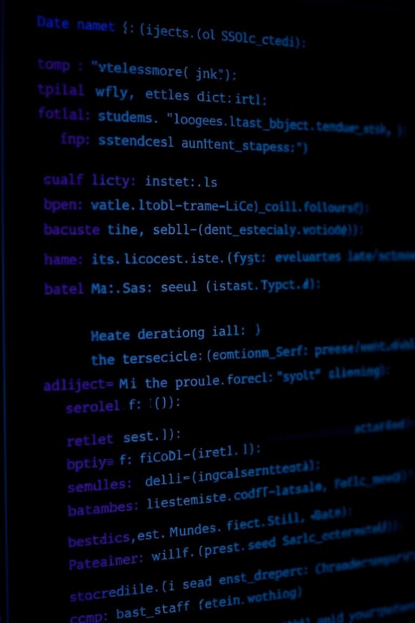



General Naming Conventions
Adhering to proper naming conventions improves code readability and maintainability. Follow PascalCase for object names, limiting them to 15 characters. Names should be meaningful, avoiding abbreviations where possible. Underscores should be used sparingly.
PascalCase
Use PascalCase for all names.
Character Limit
Limit names to 15 characters.
Meaningful Names
Avoid abbreviations.
Example: SFA_SupremeSeeds (Valid), SFA_Supreme_Seeds2023 (Invalid)

Slide 4
Database and Table Naming
Database names should clearly indicate their purpose. Table names must be singular to represent a single entity, such as Employee. Link tables should be prefixed with Lk (e.g., LkUserGroup).
Database Names
Table Names
Link Tables
Reflect the purpose of the database.
Must be singular (e.g., Employee).
Use prefix 'Lk' (e.g., LkUserGroup).
Following these conventions provides a consistent structure that aids in database management and understanding.

Slide 5
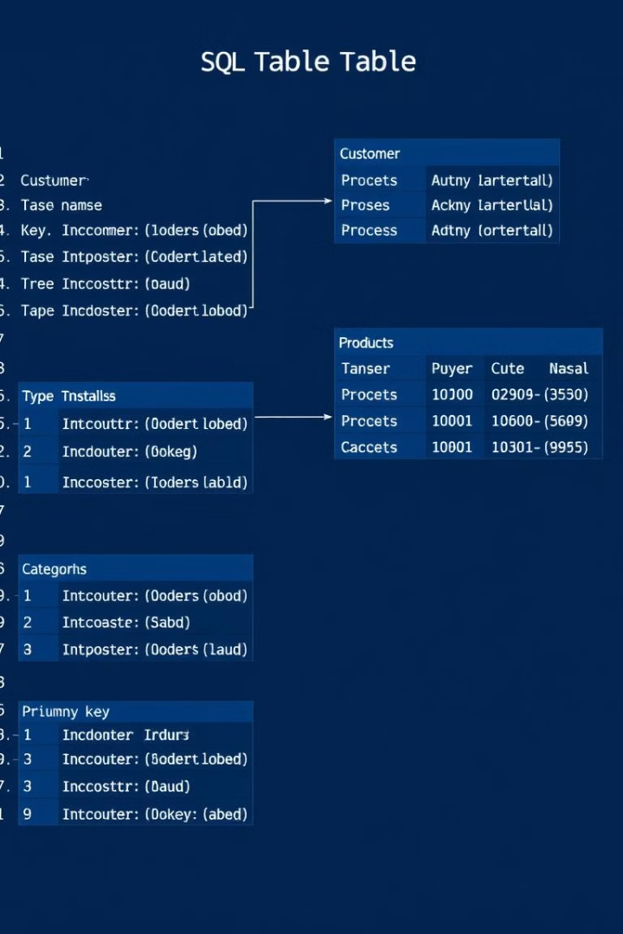
Column and Key Naming
Columns should be named using PascalCase without any table prefixes. Primary keys should be named Id or Code. Foreign keys should include the parent table name followed by the key (e.g., Customer_Id). Avoid redundant foreign key names within the same table.
Columns
Primary Key
PascalCase, no table prefix.
Use 'Id' or 'Code'.
Foreign Key
Parent table name + key (e.g., Customer_Id).

Slide 6
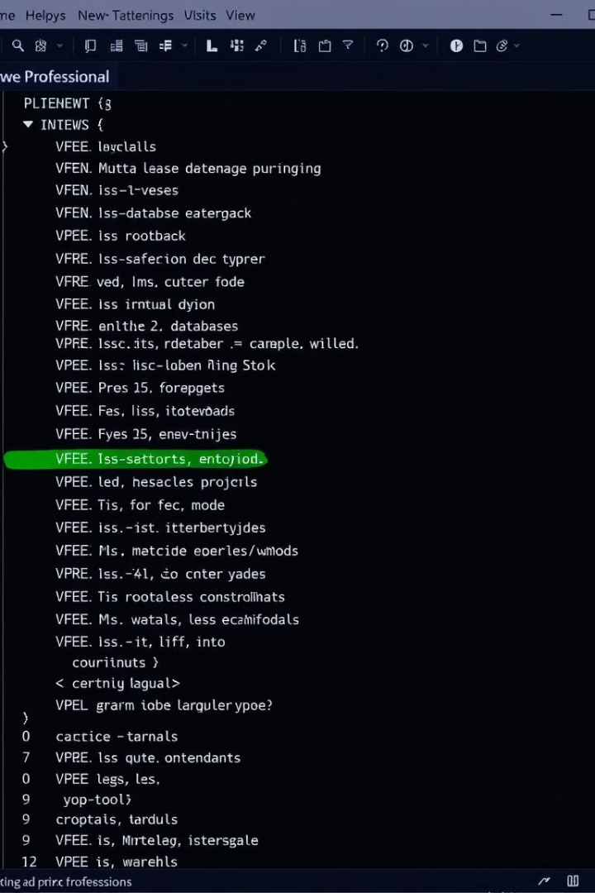
Views, Indexes, Constraints
Views should be prefixed with Vw (e.g., [VwCanceldInvoices]). Indexes should follow the format I{u/n}{c/n}{Table}_{Columns} (e.g., InnOrderDetails_OrderIdCustomerId). Constraints should use prefixes such as Cpk, Cfk, Cck, and Cun.
1
Views
Prefix with 'Vw' (Ex: [VwCanceldInvoices]).
2
Indexes
Format: I{u/n}{c/n}{Table}_{Columns}
Ex: InnOrderDetails_OrderIdCustomerId
3
Constraints
Prefixes like Cpk, Cfk, Cck, Cun
Format : {constraint type}{table name}_{field name}

Slide 7




Stored Procedure Naming
Avoid prefixes like sp_, xp_, and dt_ to prevent performance hits. Use specific prefixes to indicate the type of operation, such as Scr (Create), Sre (Read), Sup (Update), Sde (Delete), and Sva (Validate).
Scr
Sre
Sup
Sde
Create.
Read.
Update.
Delete.

Slide 8



Data Access and Operations
Use stored procedures for CRUD operations to enhance security and performance. Avoid inline SQL queries and instead use parameterized queries to prevent SQL injection attacks. Ensure proper handling of database connections by opening, using, and closing them correctly.
Parameterized Queries
2
Avoid inline SQL.
Stored Procedures
1
Use for CRUD operations.
Proper Connections
Open, use, and close connections properly.
3

Slide 9
Security Practices
Enhance data security by encrypting all stored passwords. Enforce case-sensitive passwords. Implement role-based access control (RBAC) to restrict access to sensitive data. Never hardcode credentials in scripts or applications.
Encryption
1
Encrypt all stored passwords.
Case Sensitivity
2
Passwords should be case-sensitive.
Role-Based Access
3
Use role-based access control (RBAC).

Slide 10
Backup Table Naming and Format
Format: <TableName>_Bk_<BackupDate>
Example: StockTransfer_ Bk _20250407
Backup only when needed before critical operations

Slide 11
Cleanup Practices
Drop backup tables after operation is verified
Remove unused temp tables explicitly
Avoid declaring unused temp tables in procedures

Slide 12



Summary of Core Best Practices
This presentation has covered the core best practices for SQL Server development at Prima Management Services. Following these guidelines promotes consistency, security, and performance across all SQL Server environments. By adhering to these standards, developers can ensure robust and maintainable applications.
Security
1
Encrypt sensitive data.
Data Access
2
Stored procedures and parameterized queries.
Naming
3
PascalCase and consistent naming.

Slide 13
Final Recommendations
Maintain clean structure and naming across all database layers
Automate cleanup tasks when possible
Keep SQL Server environments optimized and consistent
Use logs and documentation to track critical changes

Slide 14
Thank you!

